Slide 1
Technical Communication
Tofigh Heidarzadeh, PhD
https://www.thepunctuationguide.com/em-dash.html
http://www.sjsu.edu/writingcenter/handouts/Concrete%20Language.pdf
http://grammar.yourdictionary.com/style-and-usage/sexist-language.html
https://msu.edu/course/be/485/bewritingguideV2.0.pdf
https://projects.iq.harvard.edu/files/hks-communications-program/files/how_to_write_an_exex_summ_to_use_4_18_18.pdf
D. F. Beer and D. A. McMurrey, A Guide to Writing as an Engineer, 4th ed. New York: Wiley Publications, 2014.

Slide 2
References:
S. M. Gerson, A Teacher’s Guide to Technical Writing. Kansas Curriculum Center, Washburn University, http://toefl.uobabylon.edu.iq/papers/itp_2015_41931767.pdf
D. F. Beer and D. A. McMurrey, A Guide to Writing as an Engineer, 4th ed. New York: Wiley Publications, 2014.
“Characteristics of Technical Writing,” http://upcp.ece.gatech.edu/docs/curriculum/Characteristics_of_Technical_Writing.pdf
G. Youssef and V. Durgesh, “Technical Writing,” Mechanical Engineering Department, California State University Northridge, http://www.ecs.csun.edu/asme/Technical_Writing_11-12-2014.pdf
N. Kelley, “Sentence Structure of Technical Writing.” Program in Writing and Humanistic Studies at MIT.
Note: Texts in PPT slides are directly from reading materials.

Slide 3
Course Objectives
To introduce technical communication and documentation skills
To use your capstone design project as a case study and edit your report based on technical writing standards
To introduce you professional and ethical responsibilities, contemporary issues in engineering and global impact on economics, society, and the environment
To make you a better writer!

Slide 4
Being Effective in ANY Role
There are three basic components to any profession…
Technical Skills
Business Skills / Job Knowledge
Human Skills

Slide 5
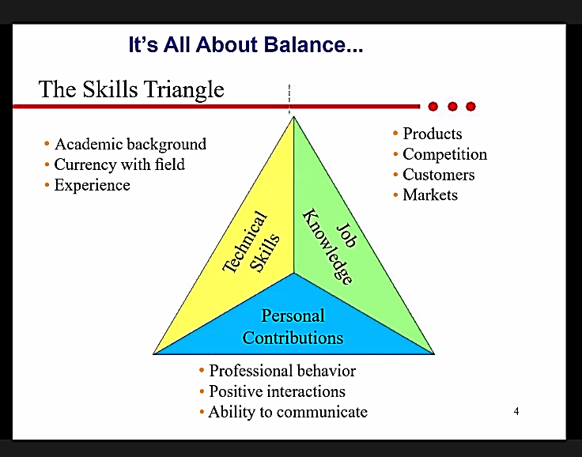

Slide 6
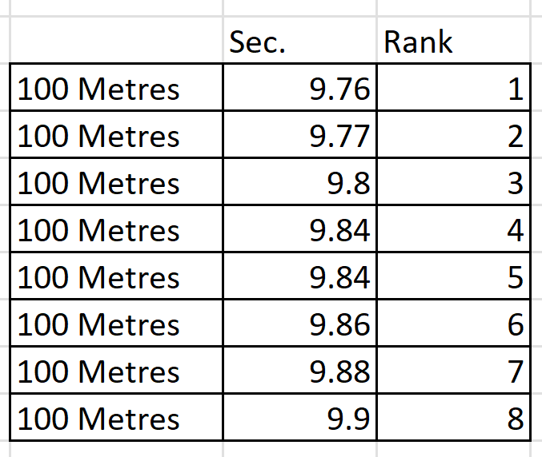
The 100 meters sprint race records

Slide 7
The Executive Summary
Thank about a 5-minute meeting with an entrepreneur
You want he/she invest in your project or buy your product
How can you introduce your project/product?
List the most important features
Find a logical sequence/connection between each item
Make an interesting/attractive conclusion

Slide 8
The Executive Summary
Provides an overview of the main points of a long report.
It is often written for people who do not have time to read the entire report.
The reader should be able to make a decision based only on reading the executive summary.

Slide 9
The Executive Summary should:
Summarize the key points of the report.
Restate the purpose of the report
Highlight the major points of the report
Describe any results, conclusions, or recommendations from the report.
It should include enough information so the reader can understand what is discussed in the full report, without having to read it.

Slide 10
An executive summary should…
Be presented as a document that can stand on its own
• Be one to three pages, depending on the length of the report
Structure:
Introduction
Body
Conclusion
A typical executive summary includes:
Problem statement
Proposed solution
Expected outcomes
Conclusion

Slide 11
Structure of the Executive Summary
1. Introduction
Purpose of the Report
Scope
Context: A brief explanation of the background or situation that led to the creation of the report.
2. Methodology
3. Key Findings
4. Analysis (A high-level overview of the analysis)
5. Conclusions
6. Recommendations/ Implications (optional)
8. Call to Action (optional)

Slide 12
Tips for Writing an Executive Summary:
Keep it brief: The executive summary should be short—typically one to two pages, depending on the length of the full report.
Be clear and concise: Avoid unnecessary jargon and overly detailed explanations. The goal is to summarize the report in a way that is easy for anyone to understand.
Write it last: Although it appears at the beginning of the report, it’s usually easier to write the executive summary after completing the rest of the report.
The executive summary should be able to stand alone as a summary of the report, so that if a reader only has time to read the summary, they can still understand the key points and outcomes.

Slide 13
* Executive Summary
In one page, present the summary of your project.
□ Outline the motivation,
□ Overall goals,
□ Design objectives,
□ Key features,
□ Testing results, and
□ Your important achievements.
You want to convince the readers succinctly that your project is important, useful, makes a good senior design project and you succeed in achieving your design objectives.
You may use several paragraphs, but no more sub-sections.

Slide 14
Avoid General Discussions
Avoid Textbook Style Writing
Avoid Narrative style
Avoid Irrelevant Information
Avoid Long Sentences and Long Paragraphs

Slide 15
Bad Executive Summary
1. Executive Summary
In a study conducted by the AAA Foundation for Traffic Safety, an estimated 21, 292 crashes were recorded in 2009-2013. Approximately 10% of those crashes involved distracted or sleepy drivers. 21% of those crashes involving a drowsy driver were fatal. Currently even the most expensive vehicles available are not equipped with any type of system that detects when a driver falls asleep. Some modern vehicles detect obstacles on the road and employ autonomous driving to avoid accidents, but there are currently no cars with systems that detect the activity of the driver.
The main goal of this senior design project is to provide a driver monitoring system that can detect when a driver is falling asleep, and an alarm system to wake the driver up before an accident occurs. The title of the project is the Safe Driving System and it is a two-part device. The first part is an Electroencephalogram (EEG) system that analyzes the electrical activity of the brain as the drivers operate a vehicle. The second is a camera system aimed at tracking the eyes of the driver. …….

Slide 16
Bad Executive Summary
1. Executive Summary
Autonomous vehicle uses sensors and cameras to drive on its own without human interaction. Today, there is about 33 corporations working on their own implantation like Google and Uber. In February 2017, automated cars are permitted on public roads, but a human driver is behind the wheel to take over if there are any problems with the car. Self-driving cars use sensors and cameras to take the next step; for example, drive right if object detection is on the left, but is that enough. The key problem is none of these cars are aware of their surroundings, the car cannot make the right decision based just on cameras and sensors, they must make better decision than a human mind. That is where neural networks come into place.
Neural networks for short, is a human brain in a computer that can learn on its own and make accurate predictions based on its surroundings. By implementing a Neural network vehicle, the vehicle drives better with enhanced decisions.…….

Slide 17
Bad writing
Design Objectives and System Overview
This solar powered wireless charging system for electric vehicles introduces an alternative to the current way of charging electric vehicles. We have established an at-home wireless charging station, similar to those for mobile and handheld devices, that is powered by solar cells — installed on the roof of a home or commercial property, that removes the hassle of having a charging cable and utilizes the convenience of wireless power transfer .
(49 words)
C-

Slide 18
Bad writing
The movement towards everything being wireless is current being put in effective . When considering wireless applications wireless power transfer is a very big subject . Toothbrushes have used this technology for years now and now phones have all recently been built to receive power wirelessly but now the new application is for electric vehicles due to them sprouting worldwide .
D

Slide 19
Very Bad writing
The Pick and Place robot is a smart machine is designed for great changes and advantage to our life. Many problems have been solved by robot and our life quality has been elevated to a level that our ancestors may have never dreamed of. A robot can work 24 hours a day for years on end with no failures whatsoever. Though it is reprogrammable, in many app. It is programmed once and then repeat that exact same task for years.
F

Slide 20
Very Bad writing
For the further details, when the camera receive the signals from phone app, it will identify which staff from the users instructions. The camera pass signals back to microcontroller and start to move the grabber to pick the staff. In the meantime, the robot will move up through motor. Finally, we will place the staff where we suppose to.
F

Slide 21
Limitations of AI
AI is powerful but imperfect
Cannot replace human judgment
Needs careful supervision
Risk of overreliance
Ethical concerns arise
Critical evaluation required
Notes:
Visual suggestion: Warning icon + balance scale

Slide 22
Con 1 – Accuracy Issues
AI may produce incorrect info
Example: wrong circuit explanation
Example: incorrect formulas
Hallucinated references
Requires verification
Risk in technical reports
Notes:
Visual suggestion: Incorrect vs correct circuit diagram

Slide 23
Con 2 – Loss of Learning
Students may skip thinking
Overreliance reduces skill development
Example: copying AI-generated text
Weakens critical reasoning
Less engagement with material
Impacts long-term competence
Notes:
Visual suggestion: Student vs AI thinking diagram

Slide 24
Con 3 – Plagiarism Risks
AI-generated text may be reused
Difficult to detect originality
Example: identical lab reports
Violates academic integrity
Challenges grading fairness
Requires clear policies
Notes:
Visual suggestion: Plagiarism similarity visual

Slide 25
Con 4 – Superficial Writing
AI produces generic explanations
Lacks depth and originality
Example: vague system descriptions
Misses project-specific details
Reduces technical precision
Needs student refinement
Notes:
Visual suggestion: Generic vs detailed writing comparison

Slide 26
Con 5 – Context Limitations
AI lacks full project context
Example: misinterpreting design goals
Example: wrong assumptions
Cannot access real lab setup
May misrepresent results
Requires human correction
Notes:
Visual suggestion: Project context diagram

Slide 27
Con 6 – Ethical Concerns
Ownership of AI-generated work
Transparency in usage
Bias in AI outputs
Responsibility for errors
Professional accountability
Need for disclosure policies
Notes:
Visual suggestion: Ethics balance icon

Slide 28
Con 7 – Assessment Challenges
Hard to evaluate student work
Who wrote the report?
AI vs student contribution
Example: identical structures
Requires new assessment methods
Oral exams may be needed
Notes:
Visual suggestion: Assessment flowchart

Slide 29
Con 8 – Overconfidence
AI outputs appear authoritative
Students may trust blindly
Example: incorrect calculations accepted
Reduces skepticism
Danger in engineering contexts
Encourage verification habits
Notes:
Visual suggestion: Warning sign for overconfidence

Slide 30
Best Practice 1 – Guided Use
Allow AI for brainstorming only
Require drafts and revisions
Students must justify content
Use AI as assistant, not author
Encourage critical evaluation
Provide clear instructions
Notes:
Visual suggestion: Guided workflow diagram

Slide 31
Best Practice 2 – Verification
Require source checking
Cross-check formulas and data
Example: verify circuit analysis
Encourage manual calculations
Use multiple references
Develop validation skills
Notes:
Visual suggestion: Checklist verification diagram

Slide 32
Best Practice 3 – Assessment Design
Use in-class writing tasks
Oral presentations of reports
Explain design decisions
Compare drafts and final work
Focus on process, not just product
Encourage originality
Notes:
Visual suggestion: Assessment redesign diagram

Slide 33
Conclusion
AI offers significant advantages
Improves efficiency and clarity
But introduces serious risks
Requires structured integration
Balance benefits and limitations
Prepare students responsibly
Notes:
Visual suggestion: Balanced scale pros vs cons

Slide 34
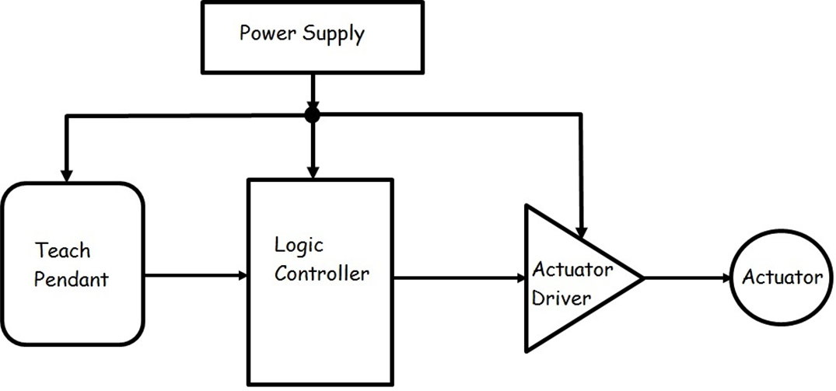
Technical writing is like a design project:
Organize & Categorize the Content
A robotic arm block diagram and its components

Slide 35

Think of a motherboard: Every component has a specific value and is there for a specific function
Can you connect ten 1 Ω resistors in series instead of one 10 Ω resistor?
Yes, but it is not smart at all!
When writing a technical text, think of designing a circuit!
5 X 2.2 kΩ = 11 kΩ

Slide 36
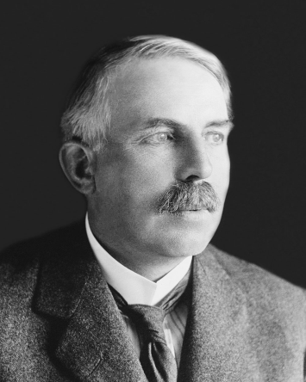
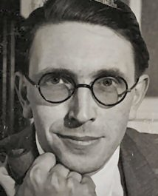
A story
Early 1930s: Ernst Rutherford, the discoverer of proton, and a prominent atomic physicist, was working on atom splitting. He didn’t like journalists and their reports about his work.
Ritchie Calder, a British journalist, insisted to visit Rutherford and write an article on the structure of the nucleus.
Rutherford: “Your readers can never understand it! Translate it!” Rutherford gives Calder the manuscript of his latest paper, full of formulas, numbers and equations.
Calder: “Let’s make a deal. You translate my shorthand and I will translate yours.” Calder hands Rutherford his notes.
Rutherford starts to explain very clearly and simply about the structure of the atom….
Some years later, Rutherford said that “if a scientist cannot explain to the person who is scrubbing the laboratory floor what he is doing, he does not know what he is doing.”

Slide 37
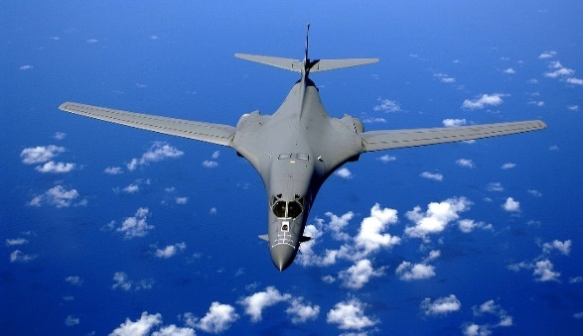
Engineers write a lot
• Engineers write many kinds of documents.
• Successful engineering careers require strong writing skills.
• Engineers can learn to write well.
B-1b bomber
Empty weight: 192,000 lb (87,100 kg)
All the proposals, regulations, manuals, procedures, and memos that the B-1b bomber project generated weighed almost as much as the bomber itself.

Slide 38
Engineers write many kinds of documents in various contexts and with different purposes and audiences.

Slide 39

Although email has perhaps become the most popular form of written communication, it does not in any way change the need for clarity and organization in engineering writing.

Slide 40
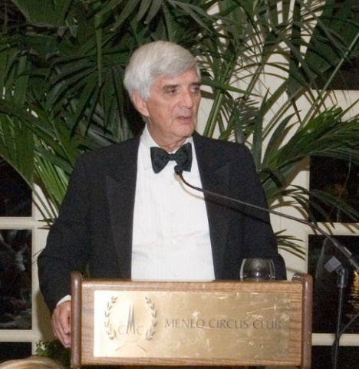
Robert W. Lucky, former Executive Director of AT&T Laboratories:
“It is unquestionably true that writing and speaking abilities are essential to the successful engineer.
Nearly every engineer who has been unsuccessful in my division had poor communication skills. …On the contrary, I have seen many quite average engineers be successful because of above-average communication skills.

Slide 41
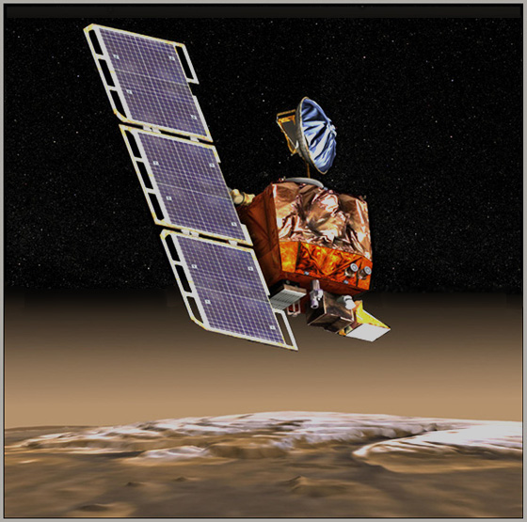

Miscommunication Disasters
The Mars Climate Orbiter a robotic space probe launched by NASA on December 11, 1998 to study the Martian climate was lost in space because engineers failed to make a simple conversion from English units to metric.
The spacecraft went into orbital insertion, due to ground-based computer software which produced output in non-SI units of pound (force)-seconds (lbf·s) instead of the SI units of newton-seconds (N·s) specified in the contract between NASA and Lockheed.
$193.1 million

Slide 42
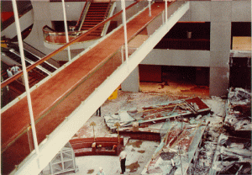
Hyatt Regency Disaster
The falling walkways killed 114 and injured 216
In July 1981, two walkways in the lobby of the Kansas City Hyatt Regency Hotel collapsed.
The cause was a structural design flaw that resulted in a decrease in the walkways’ load-bearing capacity.
But investigators concluded that the real reason those walkways collapsed was a miscommunication between the structural engineer and the steel fabricator. The drawings submitted by the structural engineer were preliminary, but the fabricator interpreted them as final.

Slide 43
What was in an engineer's email that led to the BP Deepwater Horizon blowout in the Gulf of Mexico?
Answer: One of the engineers on the rig sent an email to his manager on land, essentially pleading for help in making controversial decisions about closing off the well. The manager responded by mentioning that he was going dancing that evening and would contact the engineer the following day.
The engineer’s message was disorganized, including personal details, which made the tone seem more like a complaint rather than a request for an urgent decision.

Slide 44
What was the role of miscommunication in the Columbia Shuttle disaster?
Answer: There were two major instances of miscommunication. The first occurred when an offsite engineer sent a rambling email to the engineers who had been working around the clock to assess the extent of the damage to the shuttle’s tile. Although the engineer was close to determining what had likely happened, his email included personal issues at the beginning, which caused the engineers to overlook it.
The second miscommunication took place when the engineers presented their findings to NASA in a PowerPoint presentation. The mathematical model they used to assess the damage was not valid for such extensive damage, but they only mentioned this limitation at the bottom of the slide, where it was less likely to be noticed by the audience.

Slide 45
Features of Academic Writing (school assignments)
■ Purpose: Communicating what you know about the topic, in a way that justifies a high grade
■ Your knowledge of topic: Less than the teacher who evaluates the writing
■ Audience: The teacher who requests the assignment
■ Criteria for evaluation: Depth, logic, clarity, unity, supporting evidence, and grammar
■ Graphic elements: Sometimes used to explain and persuade

Slide 46
Features of Technical Communication
■ Purpose: Getting something done within an organization or helping a customer, client, or colleague get something done
■ Your knowledge of topic: Usually greater than that of the reader
■ Audience: Often several people with differing technical backgrounds
■ Criteria for evaluation: Clear and simple organization of ideas and supporting detail appropriate to the needs of busy readers
■ Graphic elements: Frequently used to explain existing conditions and to present alternative courses of action

Slide 47
Academic /school writing
Aims only to display your knowledge.
Responds to an assignment created by a teacher.
Is created by a student as the learner for a teacher as the source of knowledge.
Usually aims to satisfy only one person, the teacher.
Technical communication
Aims to help people make decisions and perform tasks
Responds to the needs of the workplace
Is created by an informed writer conveying needed information both verbally and visually to an uninformed reader
Is read by many readers
Places greater emphasis on techniques of organization and visual cues that help readers find important information as quickly as possible.

Slide 48
Two relatively recent trends make communication skills even more vital to the engineering profession:
A) Specialization
Due to the advancement and specialization of technology, engineers are finding it increasingly difficult to communicate with one another.
B) Accountability
Because engineers and their companies are now held much more accountable by the public, engineers must also be able to communicate with government, news media, and the general public.

Slide 49
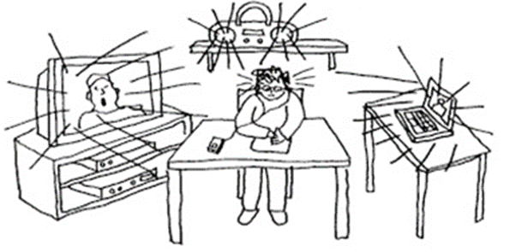

NOISE AND THE COMMUNICATION PROCESS
No concentration? Why?
You are experiencing noise interference with the transmission of information.
In written communication, we are primarily concerned with:
syntactic (grammar),
semantic (word meanings), and
organizational noise.

Slide 50
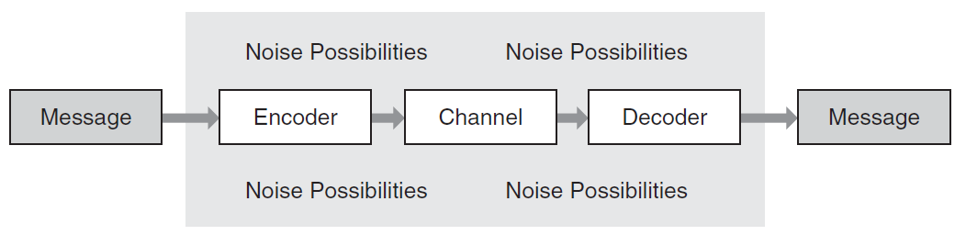
Noise
Signal
Sender
Receiver
Speech, writing, other conventional set of signs..

